Slide 1
Milestone 3: COP3060 MoodSpace
By
Logan Boone
Taylor Williams
Breanna Taffe
Shemaiah Lester

Slide 2
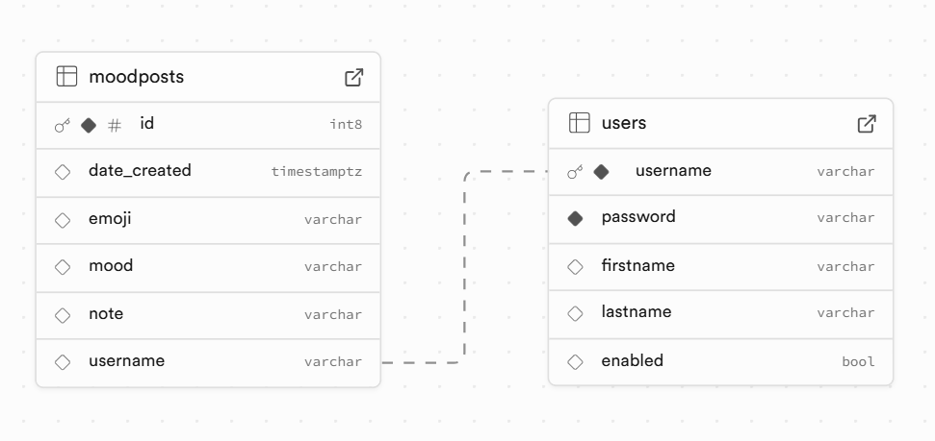
ERD 1 to Many

Slide 3
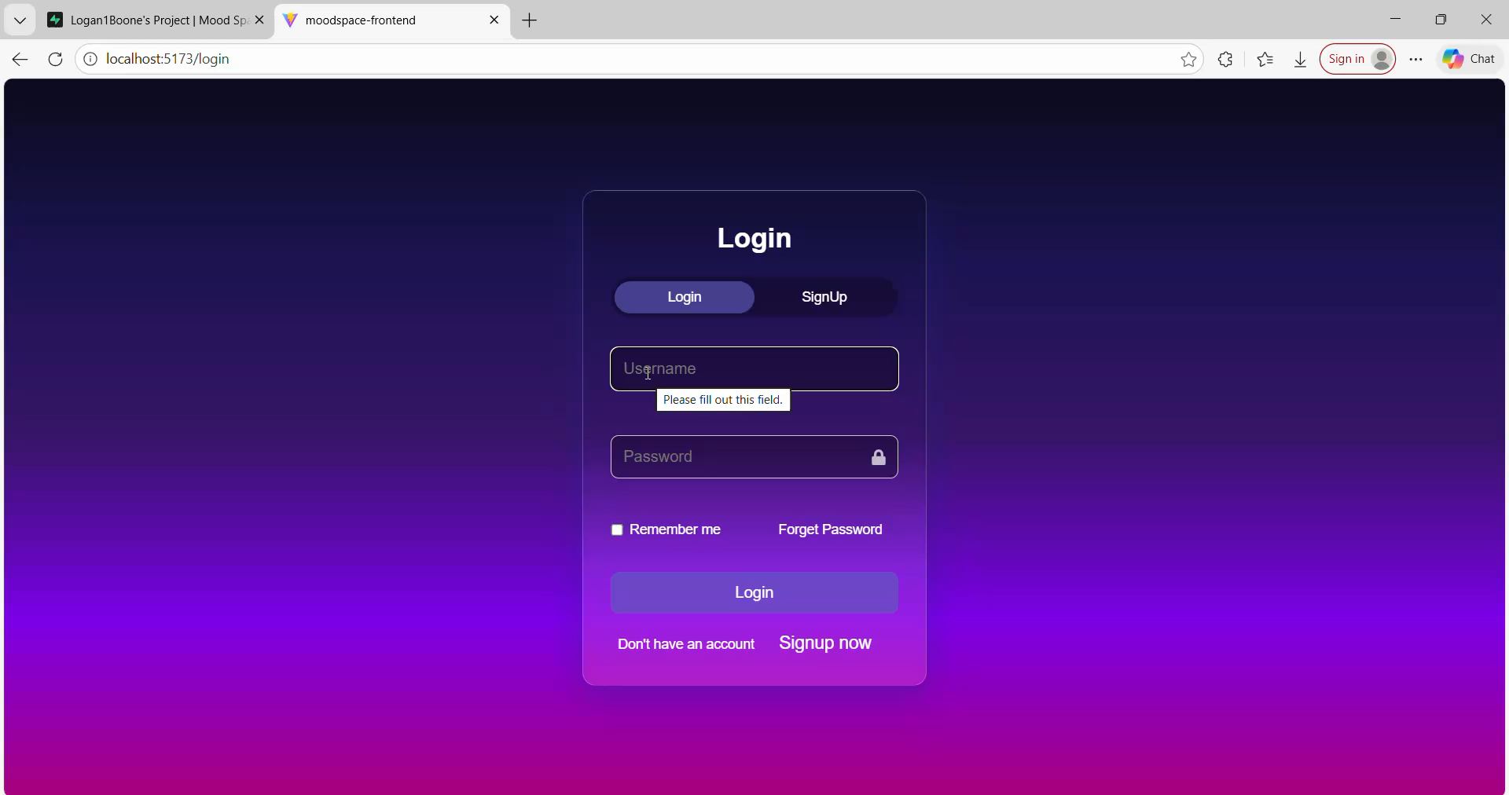
MoodSpace Demo

Slide 4
API Endpoint summary
HTTP Method | Endpoint | Description | Auth Required
POST | /auth/register | Register a new user (returns JWT) | No
POST | /auth/login | Authenticate user (returns JWT) | No
POST | /auth/mood-posts | Create a new mood post for the logged in user | Yes (JWT)
GET | /api/mood-posts | Get all mood posts | Yes (JWT)
GET | /api/mood-posts/user/{username} | Get posts for a given username | Yes (JWT)

Slide 5
AI Tool usage table
Date | AI Tool | Prompt (Summary) | Purpose | Output Used (Y/N) | Human Revisions | Ethical Reflection
12/08 | ChatGpt | Explain the backend terminal errors and the approach to fixing them | Error understanding and error debugging | Y | Used the explanation to identify the incorrect repository method and update mappings | AI provided clarification and debugging guidance, which allowed us to pivot and figure out the next step to take in a more efficient way.

